Slide 1
Analog Circuits Lab 2 Common-emitter BJT Amplifiers
· · ·
Teacher：Xu Linlin

Slide 2
目录
Contents
01 实验目的 Objectives
02 实验要点 Key points

Slide 3
01 实验目的 Objectives
1. 分析共射极放大电路的性能，加深对共射极放大电路放大特性的理解；
Analyze the performance of the common emitter amplifier circuit and deepen the understanding of the amplification characteristics of the common emitter amplifier circuit;
2. 学习共射极放大电路静态工作点的调试方法，分析静态工作点对放大器性能的影响；
Learn the debugging method of the static operating point of the common emitter amplifier circuit and analyze the impact of the static operating point on the amplifier performance;
3. 掌握放大器电压放大倍数、输入电阻、输出电阻、通频带及最大不失真输出电压的测试方法。
Master the testing methods for amplifier voltage amplification factor, input resistance, output resistance, passband, and maximum undistorted output voltage.

Slide 4
02 实验要点 Key points
I_{C}
I_{C}
I_{B}
I_{B}
Uo
C
C
B
B
E
~
I_{E}
Us
E
I_{E}
I_{C}
I_{C}
Uo
C
Uo
B
C
I_{B}
B
Us
E
I_{B}
I_{E}
E
Us
I_{E}

Slide 5
Common-emitter BJT Amplifier circuit for this experiment.

Slide 6
Calculation method for static operating point of transistor
V_{CQ}=V_{CC}－I_{CQ}*R_{C}
V_{BQ}≈V_{BEQ}＋I_{EQ}*（R_{E1}＋R_{E1}）
V_{EQ}≈I_{EQ}*（R_{E1}＋R_{E1}）
Note : V_{BEQ}≈0.7V
The amplification circuit should have a suitable static operating point！

Slide 7
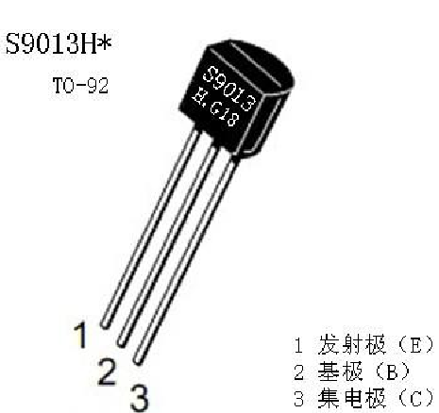
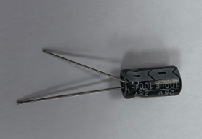
Attention
negative terminal
(shorter one)
positive terminal
(longer one)
BJT
BJT

